Slide 1
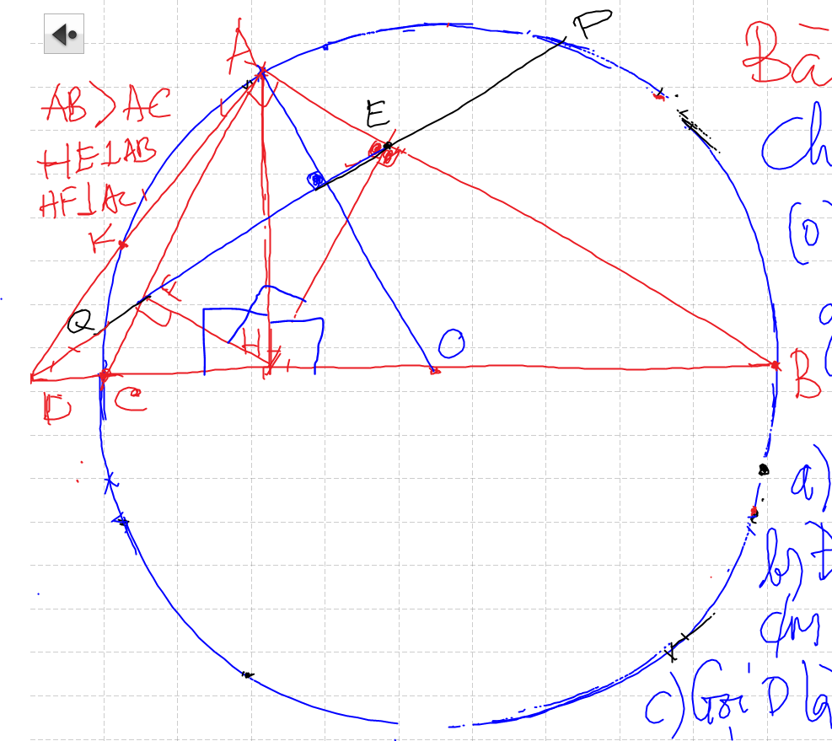
Cac hinh can ban CAN GHI NHO:
Tam giac vuong va duong cao
Tam giac noi tiep ½ duong tron va tiep tuyen
Goc co canh tuong ung vuong goc (2 goc can nhau

Slide 2
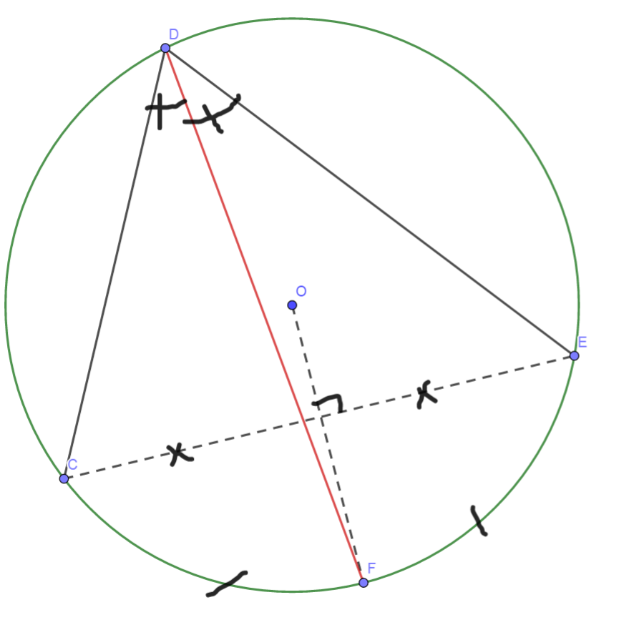
Cach ve duong phan giac cua goc noi tiep

Slide 3
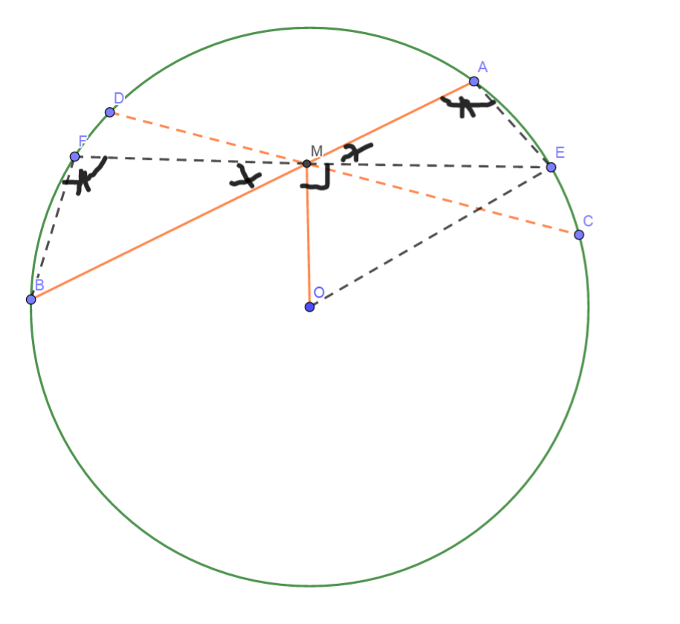
Phuong Tich cua mot diem nam ben trong duong tron
MA.MB=R²-OM²
He qua:
MA.MB=MC.MD=R²-OM²

Slide 4
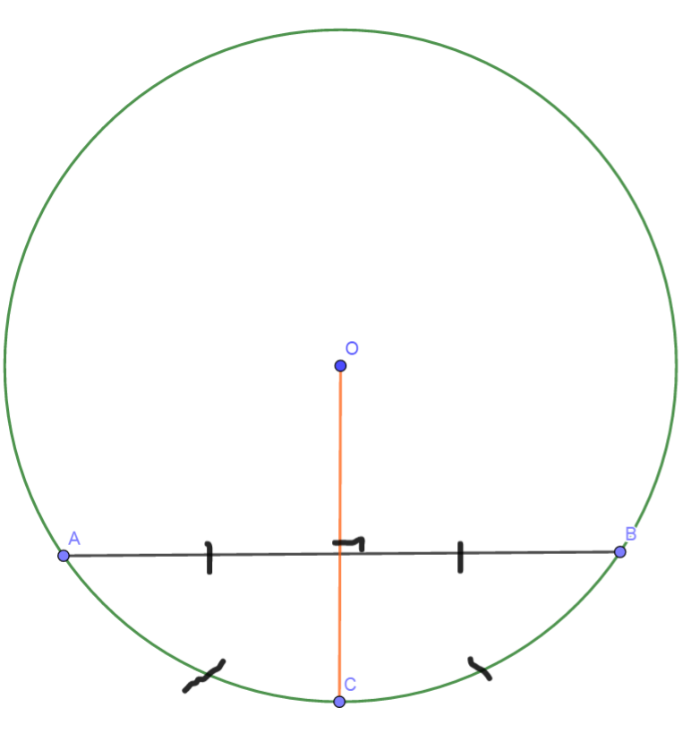
Diem chinh giua cua cung chia cung thanh 2 cung bang nhau
Duong kinh vuong goc voi day cung => di qua diem giua cua cung
Duong kinh di qua diem giua cua cung thi vuong goc voi day cung do

Slide 5
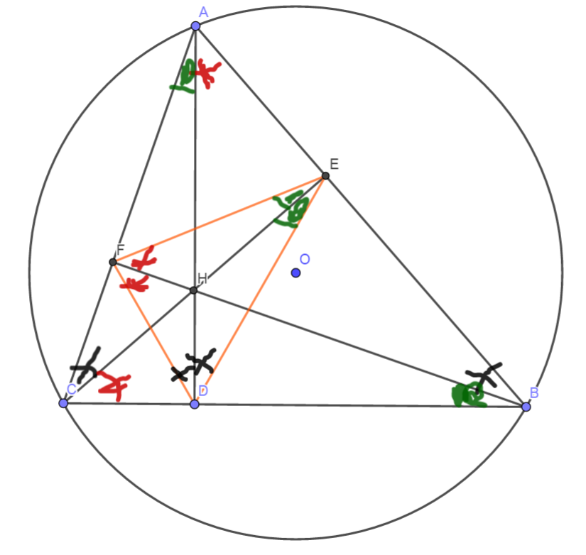
Tinh chat chan 3 duong cao
Chan 3 duong cao tao thanh tam giac DEF
3 duong cao cua tam giac ABC cung la 3 duong phan giac cua tam giac chan duong cao (DEF)

Slide 6
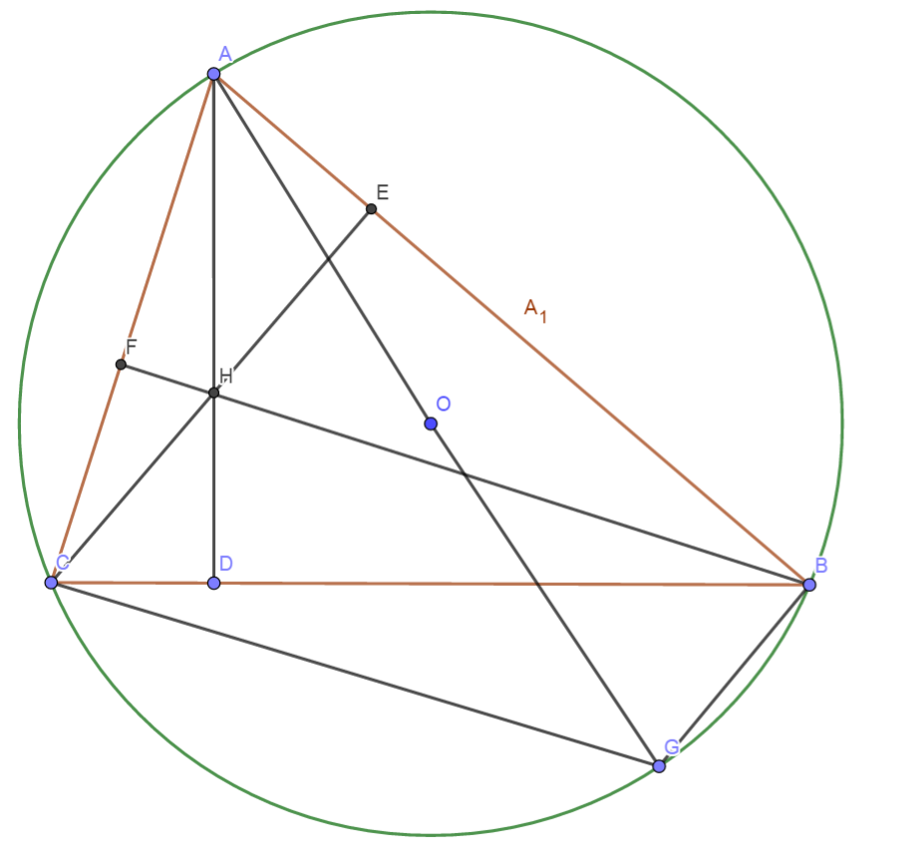
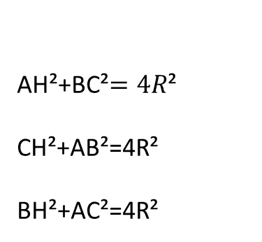
Quan he giua canh day va khoang cach den truc tam
AH²+BC²$=4R$²
CH²+AB²=4R²
BH²+AC²=4R²

Slide 7
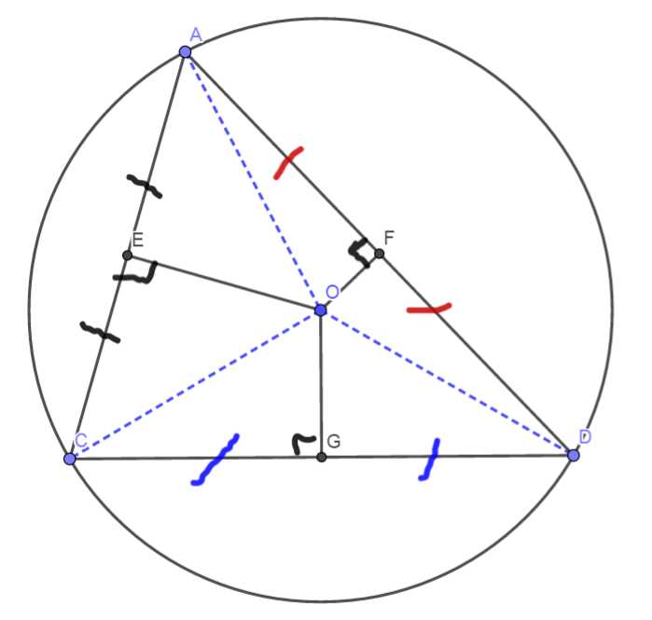
3 duong trung truc dong qui, la tam cua duong tron ngoai tiep tam giac
Giao diem cua 3 duong phan giac la tam duong trong noi tiep tam giac

